Slide 1
Predicting Diabetes
Lydia Bartnick
Anna Collawn
Gil Fernandez
Jared Sletto

Slide 2
Overview
This dataset analyzes the health of 754 individuals.
The data analyzes the following fields:
Age
Blood Pressure
Diabetes Pedigree Function
F1
Glucose
Insulin
Number of Pregnancies
Skin Thickness
We used an oversampled model to help predict the accuracy of what are the odds of a individual having diabetes based on the outcome of each of the fields above.

Slide 3

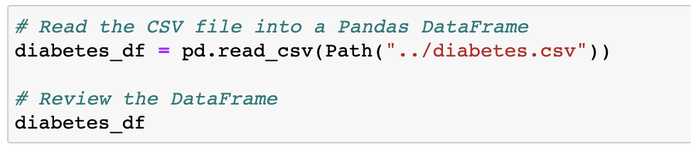
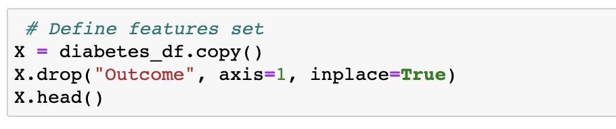
preparing the data pandas

Slide 4
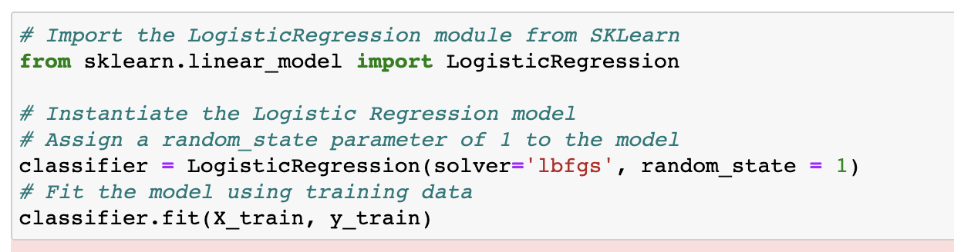
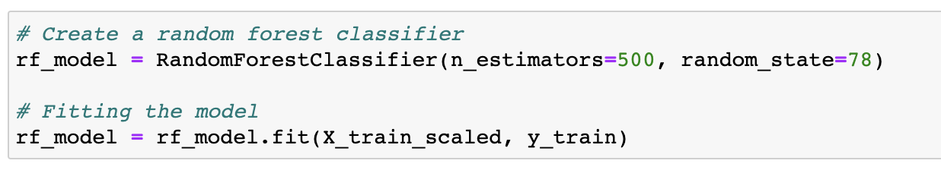
Our Models
Logistic Regression Model
Random Forest Model

Slide 5
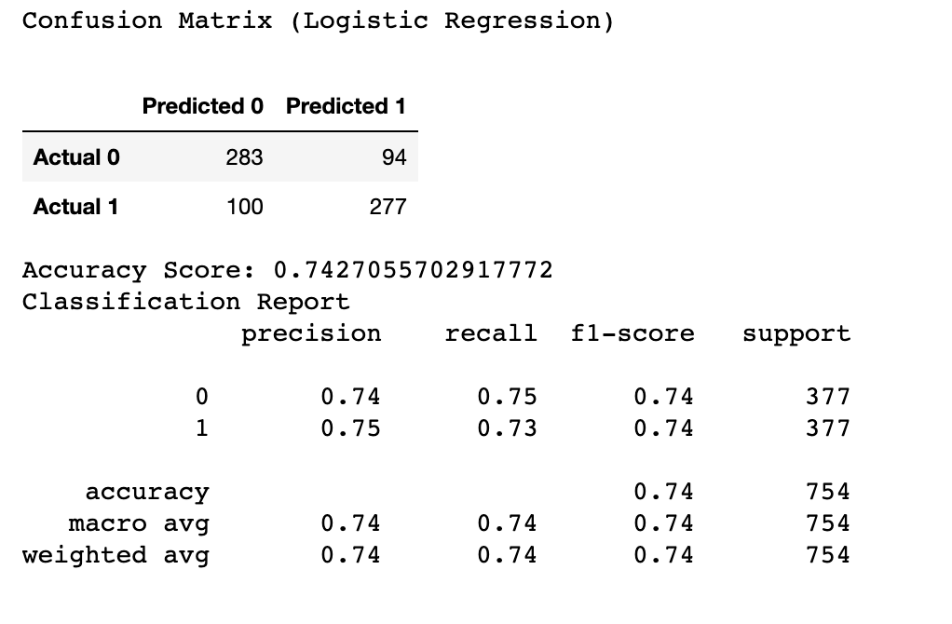
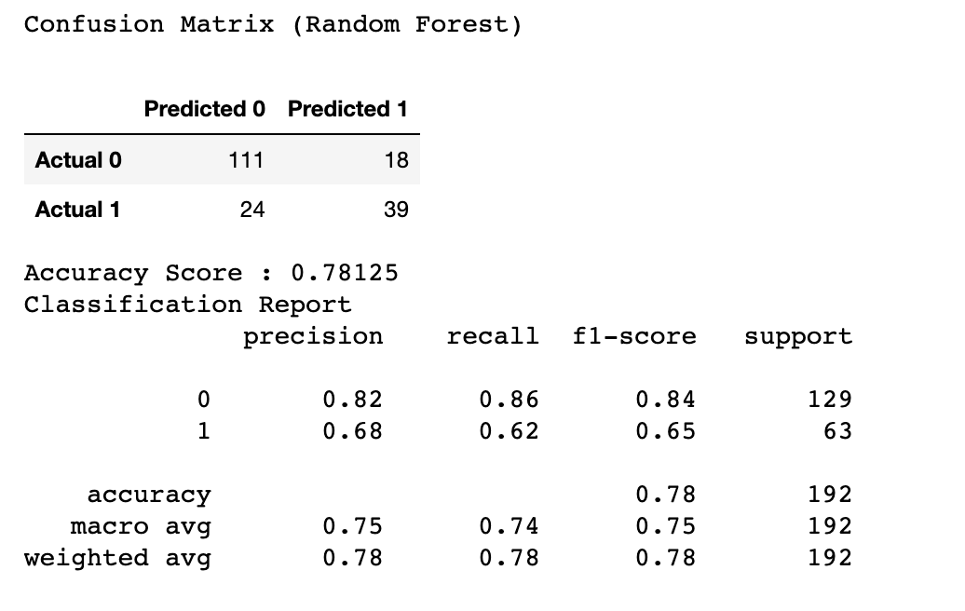
Optimized logistic regression model.
First random forest model.

Slide 6
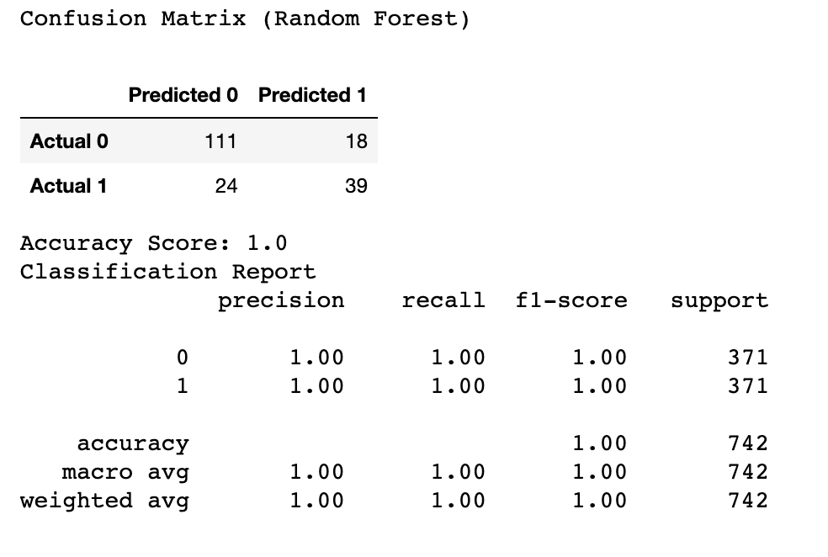
Final model
Based on the diabetes.csv data, this random forest model is able to predict if someone has diabetes of not with 100% accuracy

Slide 7
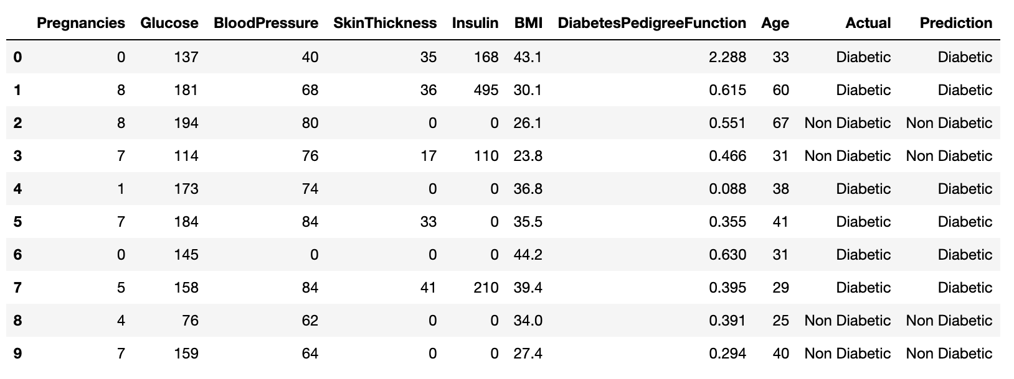
csv file for our model

Slide 8
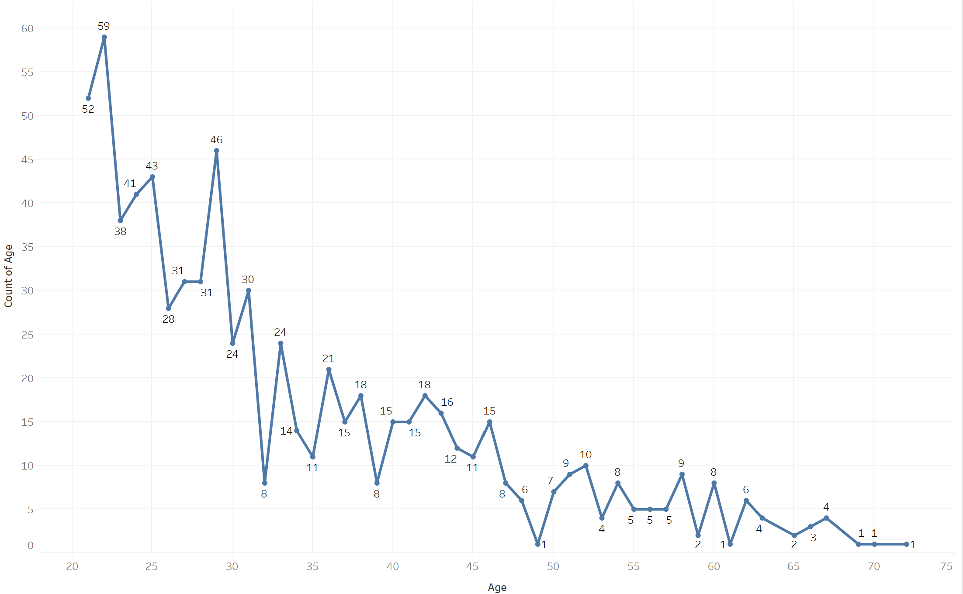
Age of Sample Size
The age of our sample ranged from 21 to 72 years old. The majority of our sample fell between 21 and 36 years old, with the highest number of individuals being 22 and 29 years old.

Slide 9
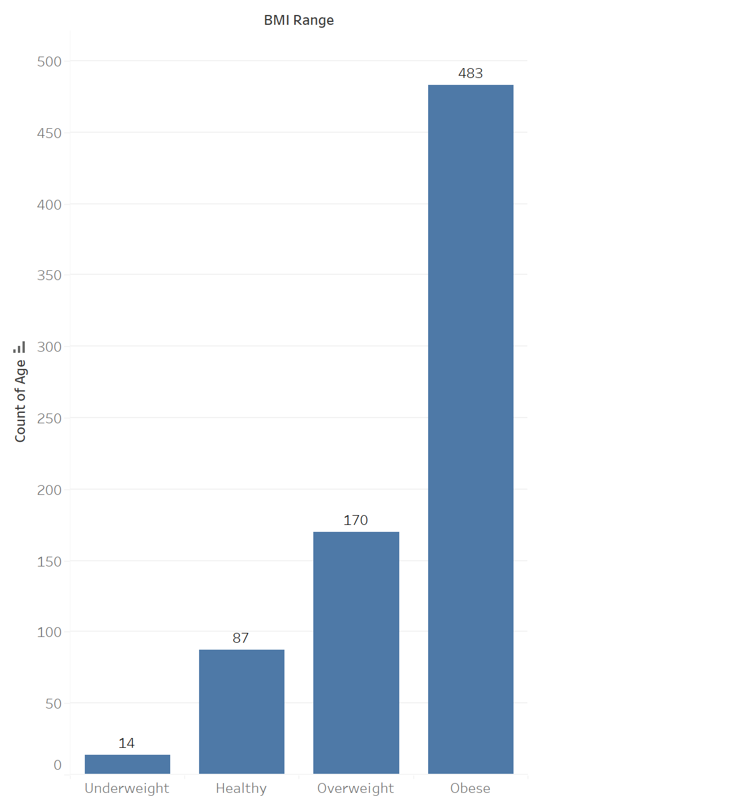
Body Mass Index (BMi)
The Body Mass Index (BMI) was broken into 4 different categories; Underweight (<18.5), Healthy (>=18.5 – 25), Overweight (25 – 30), and Obese (>30).

Slide 10
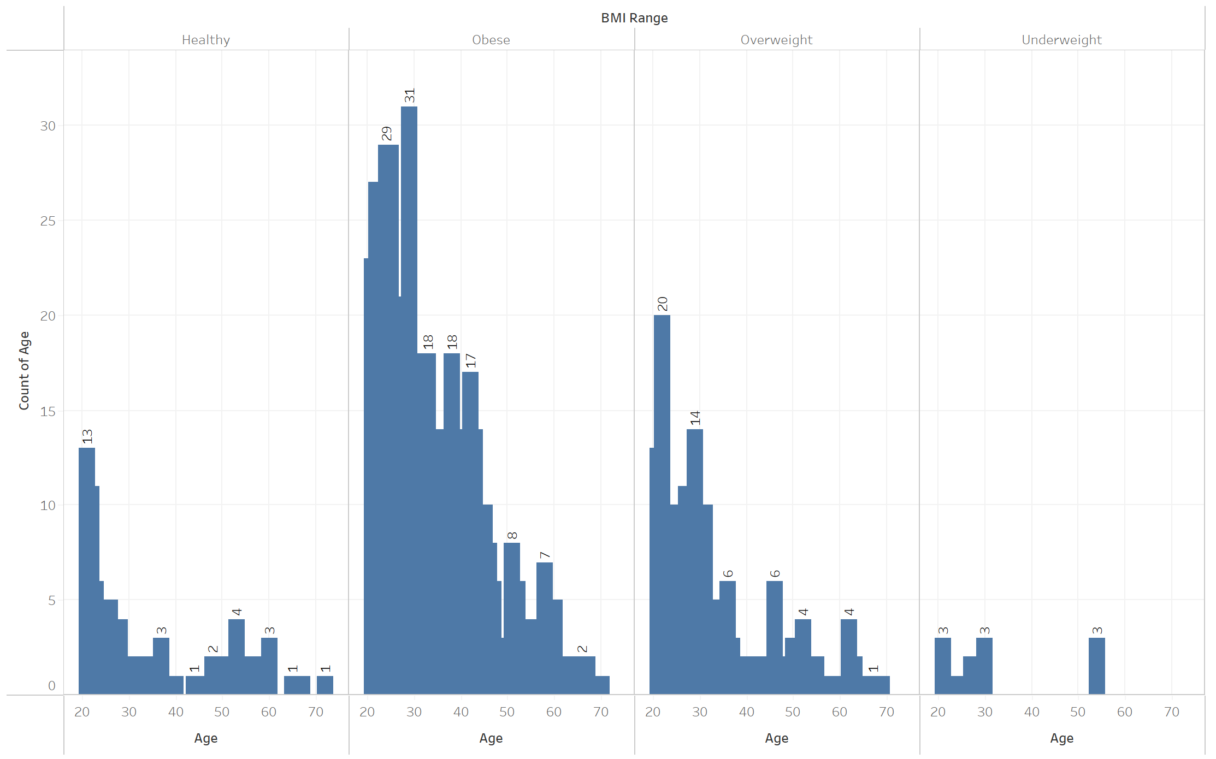
Age by BMI
The majority of our sample were considered Obese. The majority of individuals were between 20 and 30 years old.

Slide 11
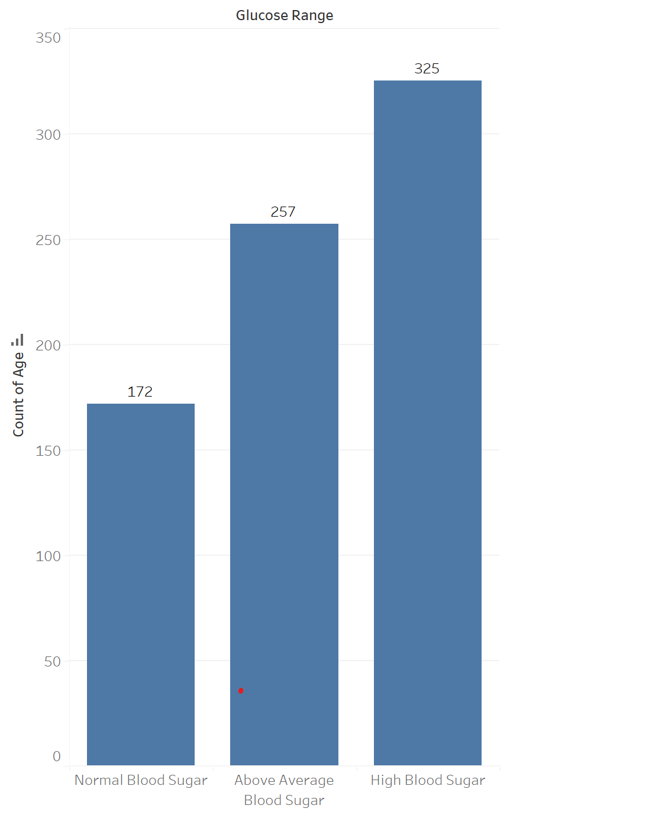
Blood Sugar Pressure
Next, we looked at what our sample’s blood sugar pressure fell. This was broken into 3 categories; Normal Blood Sugar (<= 100), Above Average Blood Sugar (100 - >=125), and High Blood Sugar (>=126).

Slide 12
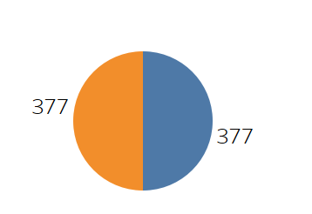
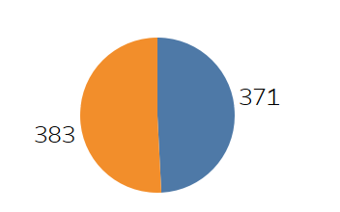

Outcome – Logistic Regression Model
Actual
Prediction
Our actual results is a 50-50 split. Our oversample model had a 74% accuracy.

Slide 13
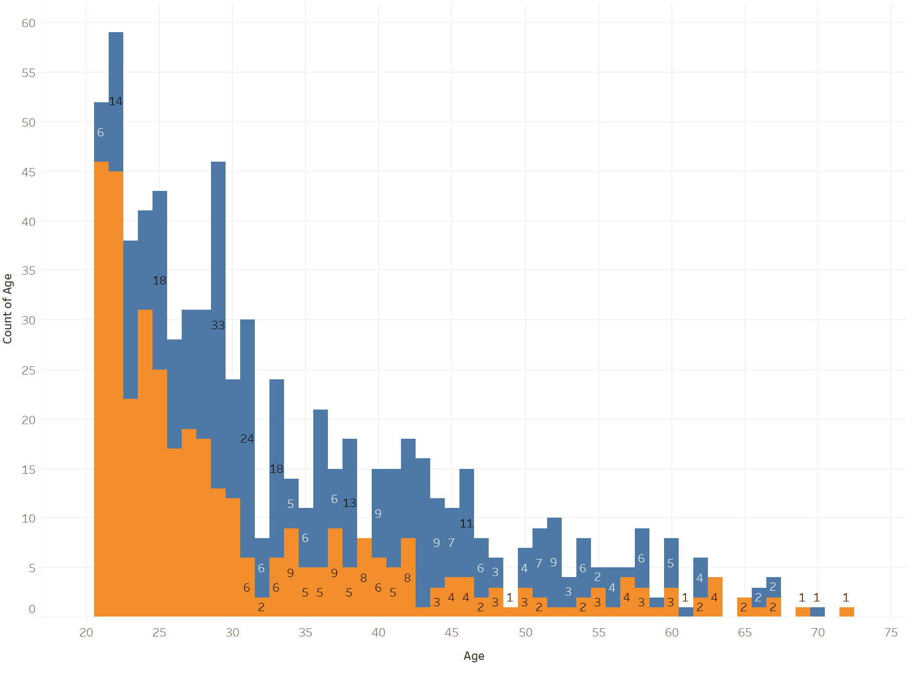
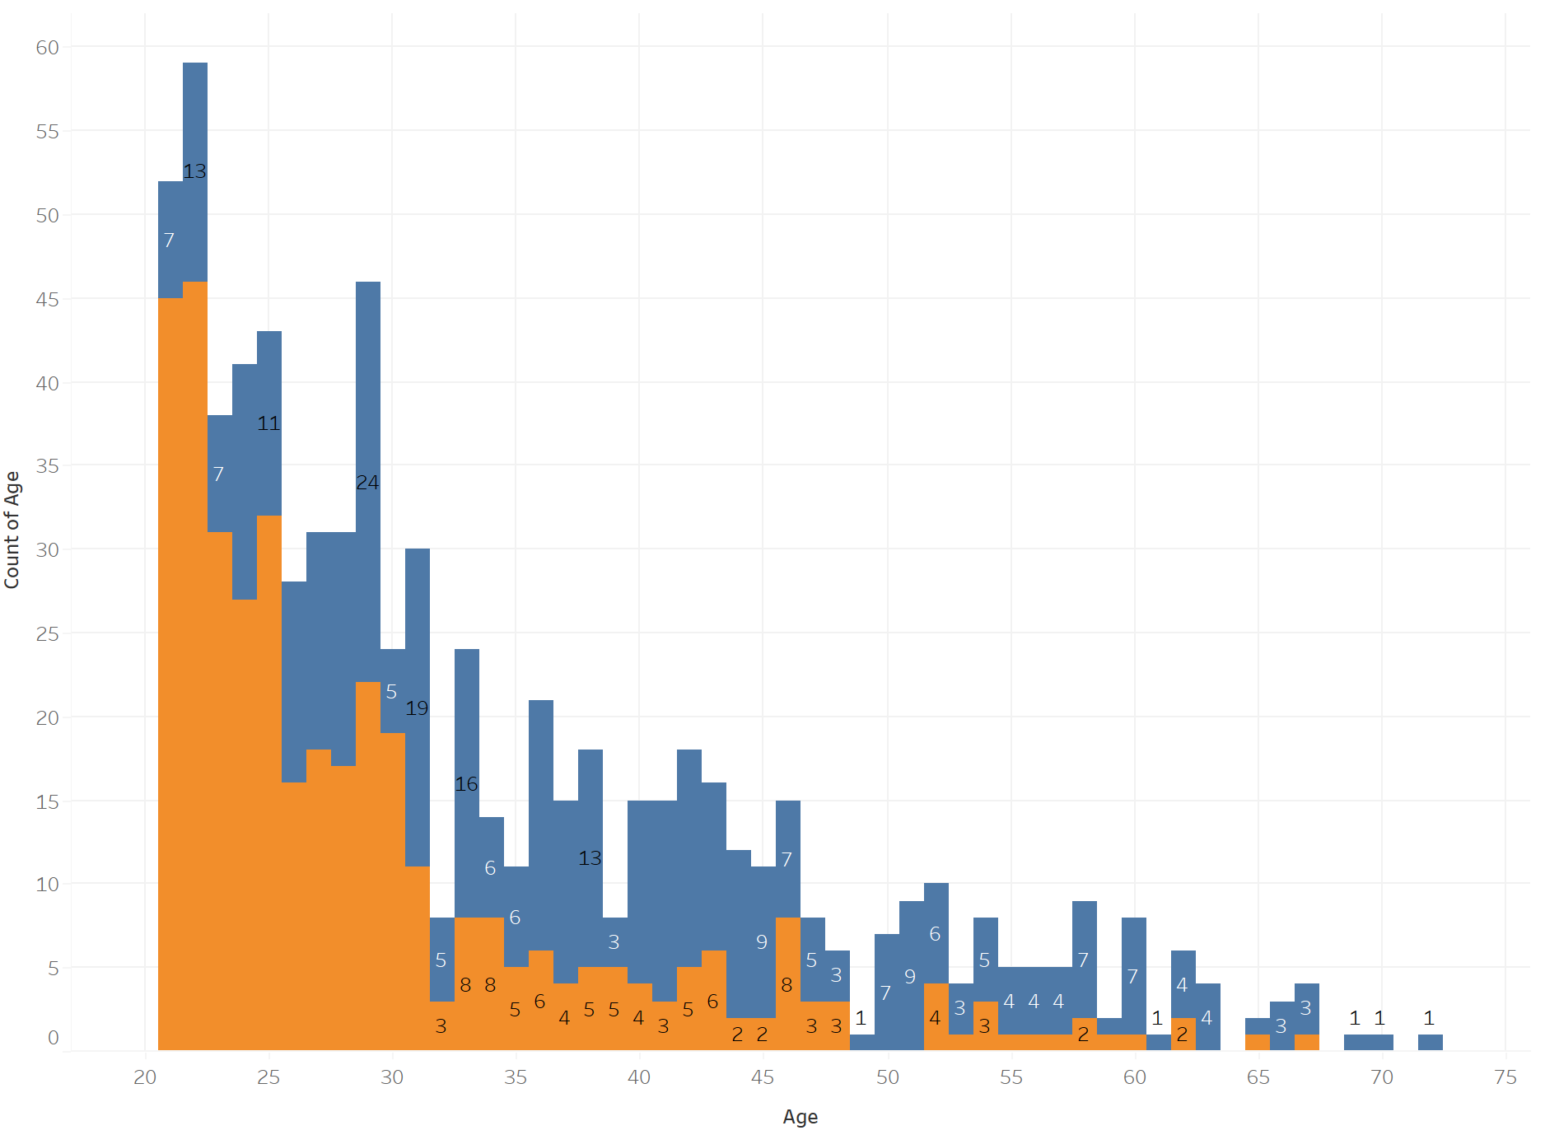
Age Outcome – Logistic Regression Model
Actual
Prediction
Notes:
While our sample had many individuals between 21 and 35 years old, a majority of the were considered diabetic. The further you move up in age, the number 0f people over 35 decreased but more were considered diabetic. This goes for both models.

Slide 14
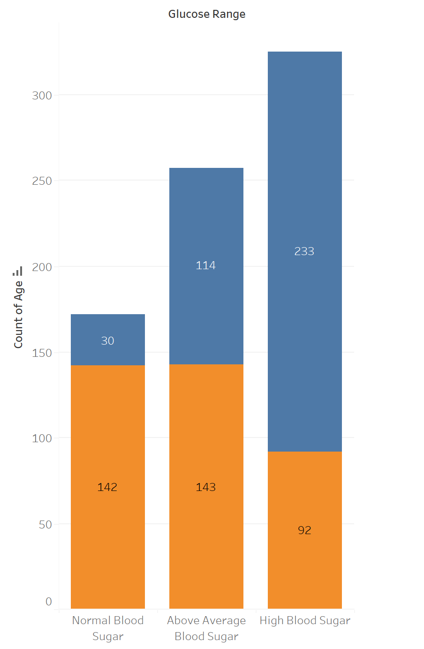
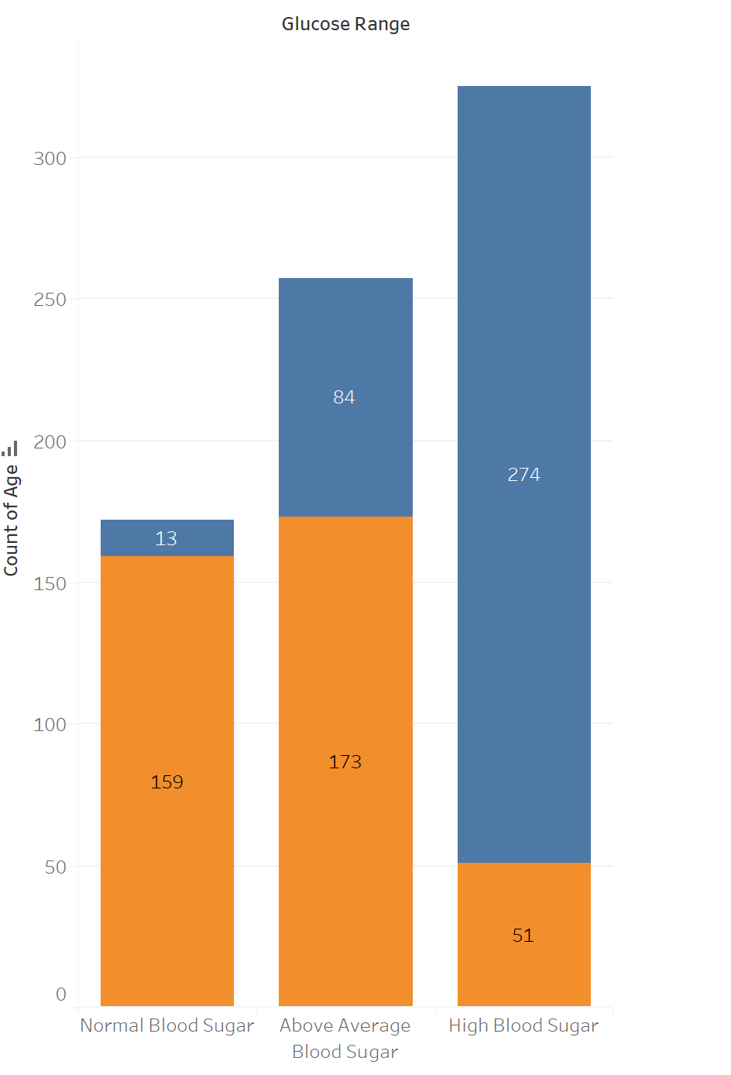
Glucose Outcome – Logistic Regression Model
Actual
Prediction
Notes:
In both models, those with normal or above average blood sugar were non diabetic, while those with High Blood Sugar were diabetic. By comparing both models you can see the oversample model (prediction) anticipated more of our sample to have high blood pressure and more of our sample to have normal to above blood pressure than our actual outcome.

